Slide 1

HR Attrition Analysis
Visualizing patterns to understand what causes employee attrition.
By Sean Ward

Slide 2
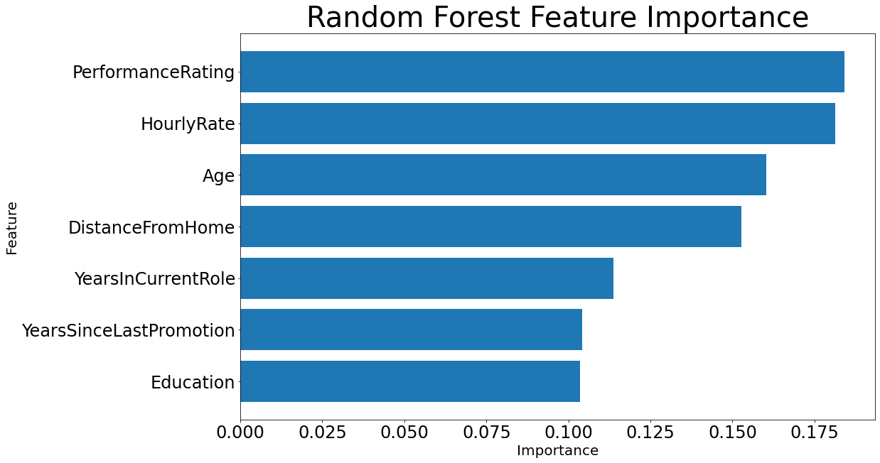

After applying the Random Forest Classifier analysis method, seven variables were determined to have feature importance.
These are the variables that can help predict whether attrition will occur with an employee:
Performance Rating
Hourly Rate
Age
Distance From Home
Years in Current Role
Years Since Last Promotion
Education

Slide 3
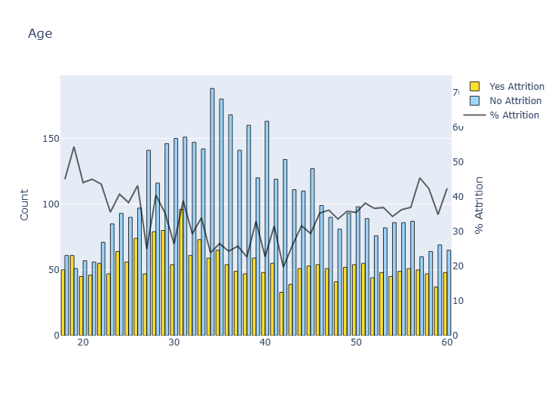

This chart seems confusing, but it’s an eye-opener!
It represents attrition/ no attrition by each age.
Yellow bars = employee count with attrition.
Blue bars = count with no attrition.
Black line = the attrition percentage per age.
Insights about Age and Attrition
From the ages of 30 to 55, it rarely is over 40% and sometimes as low as 20% attrition.
Ages 18 to 23 along with 55-60 has a 50% attrition rate.

Slide 4

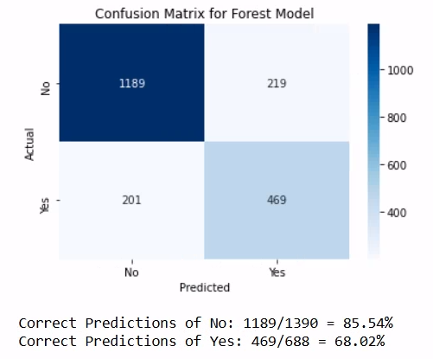
The confusion matrix shows how accurate this model was at predicting whether attrition would occur based on the variables.
Predictions of “No Attrition” for employees were 85.54% accurate. (Predicted: No, Actual: No). This is a good rate.
Predictions of “Attrition” for employees were 68.02% accurate. (Predicted: Yes, Actual: Yes). There is room for improvement.
The goal is to have a model with an 85% accuracy for predictions of “No attrition” and “Attrition.”

